Slide 2
https://mzl.la/2spfMus
Move this box to see the hints (there are two hints for this code)

Slide 3
http://www.history.com/this-day-in-history
Move this box to see the hint

Slide 4
Move this box to see the hint

Slide 5
http://rebus1.com/en/index.php?item=solve
Move this box to see the hint

Slide 6
Move this box to see the hint

Slide 7
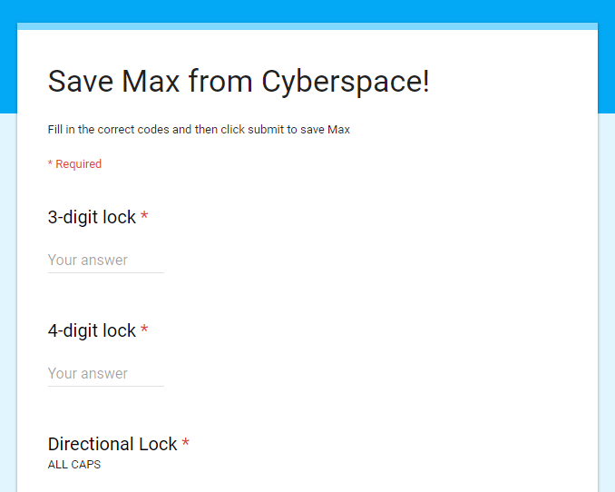
This is where you find out if you have saved Max! Open the form and fill it in with your codes. If the form lets you click submit then you have all of the correct codes.

